Slide 1



Relationship between energy consumption and co2 emissions
William stults
Western governors university
May 2023

Slide 2

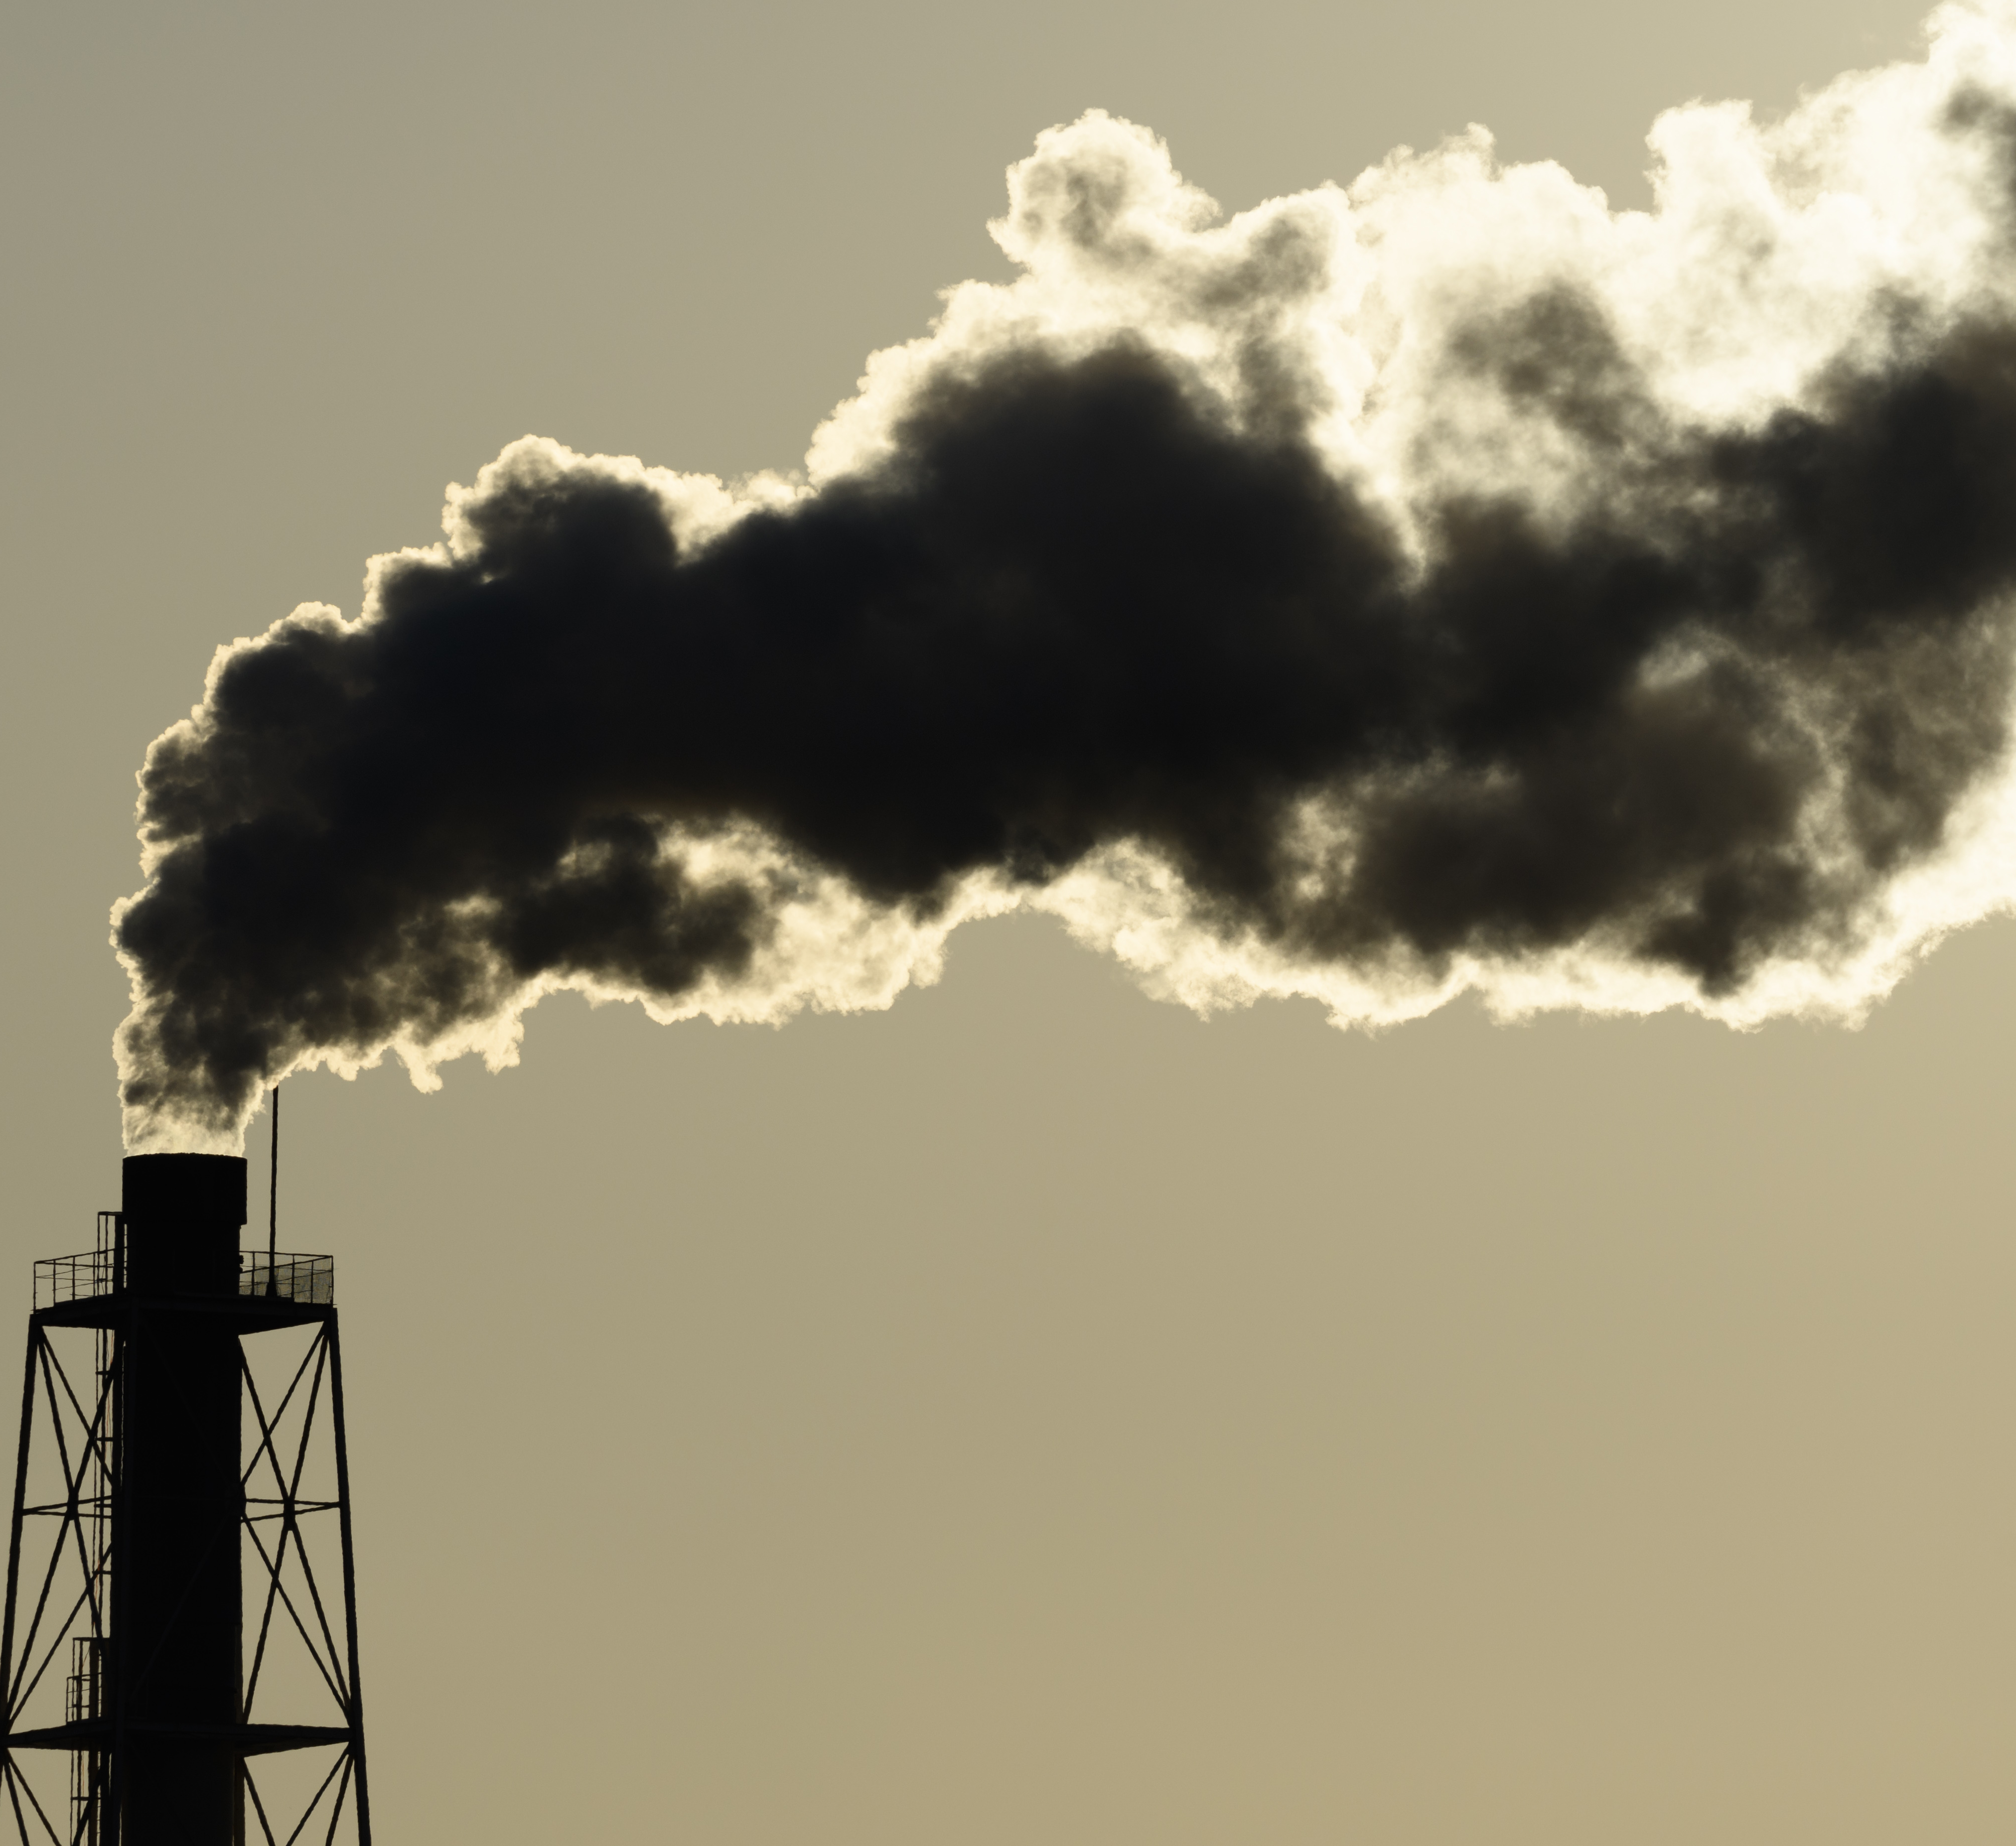
highlights
Are CO2 levels related to energy consumption?
How strong is the relationship?
What more can we learn?

Slide 3

How can we measure?
Hypothesis
a statistically significant relationship exists between energy consumption kWh and tCO2, proven via p-value ≤ 0.05 and r-squared > .90
P-value - stands for probability and measures how likely it is that any observed difference between groups is due to chance
R-squared - the percentage of the variance in the dependent variable that the independent variable explains

Slide 4

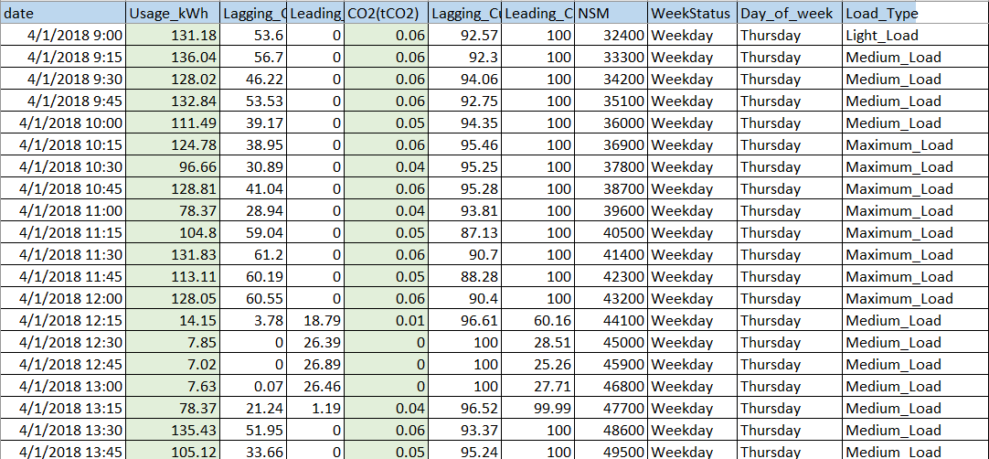
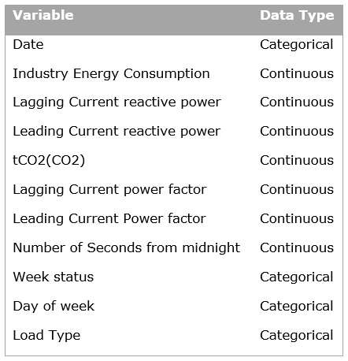
The data
https://archive.ics.uci.edu/ml/datasets/Steel+Industry+Energy+Consumption+Dataset#

Slide 5

Data analysis tools
A correlation matrix – to what degree are these two variables related? Is the relationship positive or negative? Range: -1.0 to 1.0
A linear regression model – considering our two variables, what are the p-value and r-squared value?
MSE and RSE – additional accuracy metrics; the lower, the better! Range – 0 to infinity

Slide 6

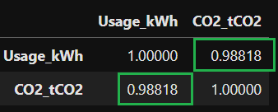
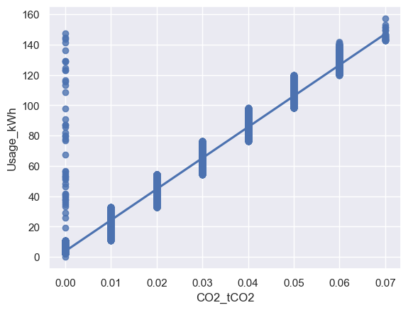

results
High degree of positive correlation
Scores closer to 0 indicate higher accuracy

Slide 7
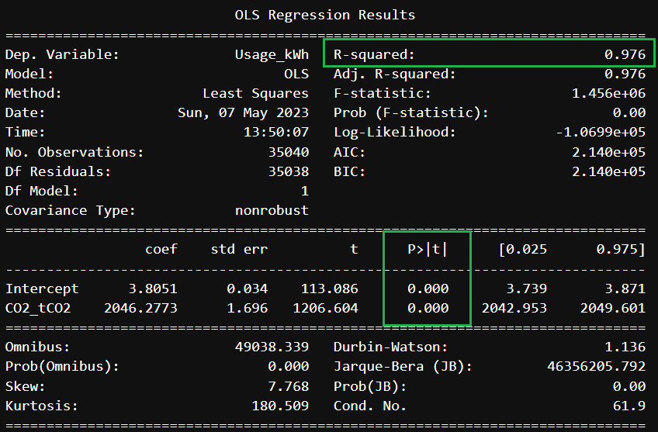
results
Energy consumption explains tCO2 97.6% of the time. A highly significant relationship is indicated.

Slide 8
limitations
A Small subset of the available data was used
Data reflects only one location and one year’s worth of measurements

Slide 9

recommendations
monitor energy consumption and make efforts to mitigate against large energy consumption spikes occurring over short periods
Expand the study to include the unused portion of the data set
Include data from more geographical locations and a longer span of time

Slide 10

citations
Dua, D. and Graff, C. (2021, March 30). Steel Industry Energy Consumption Dataset Data Set. UCI Machine Learning Repository. https://archive.ics.uci.edu/ml/datasets/Steel+Industry+Energy+Consumption+Dataset#
Center for Climate and Energy Solutions. (2021). Controlling Industrial Greenhouse Gas Emissions. https://www.c2es.org/content/regulating-industrial-sector-carbon-emissions/

